Slide 1

Go, change the world
RV College of
Engineering
Advances in Operating Systems (22MCE22TL) :
Synchronizing Accesses to Kernel Data Structures
By
Sachin JH (1RV22SCS14),
MTech CSE,
RVCE
*

Slide 2

RV College of
Engineering
Go, change the world
Introduction
Synchronization Primitives are used to protect a shared data structure from race conditions.
Depending on the type of Synchronization Primitive selected, system performance varies.
Aim is to always keep the concurrency level as high as possible in the system.
Synchronization Primitive Examples:
Semaphores
Spin Locks
SeqLocks
Local Interrupt Disabling
*

Slide 3
RV College of
Engineering
Go, change the world
Introduction
The Concurrency Level in the System depends on two main factors:
The number of I/O devices that operate concurrently
The number of CPUs that do productive work
To maximize I/O throughput --------> Interrupt Disabling
To use CPUs efficiently --------> Avoid Synchronization Primitives based on Spin Locks
*

Slide 4

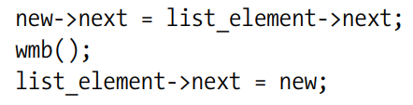
RV College of
Engineering
Go, change the world
Synchronization at High Concurrency Level
Synchronization without spin locks or disabling interrupts:
A shared data structure consisting of single integer value ----> atomic_t type and atomic operations.
Inserting an element into linked list - Contains two pointer assignments. Hence not atomic.
Two Cases:
Interrupt Handler sees the list between the execution of two instructions
Interrupt Handler sees the list after the execution of two instructions
write memory barrier primitive
*

Slide 5
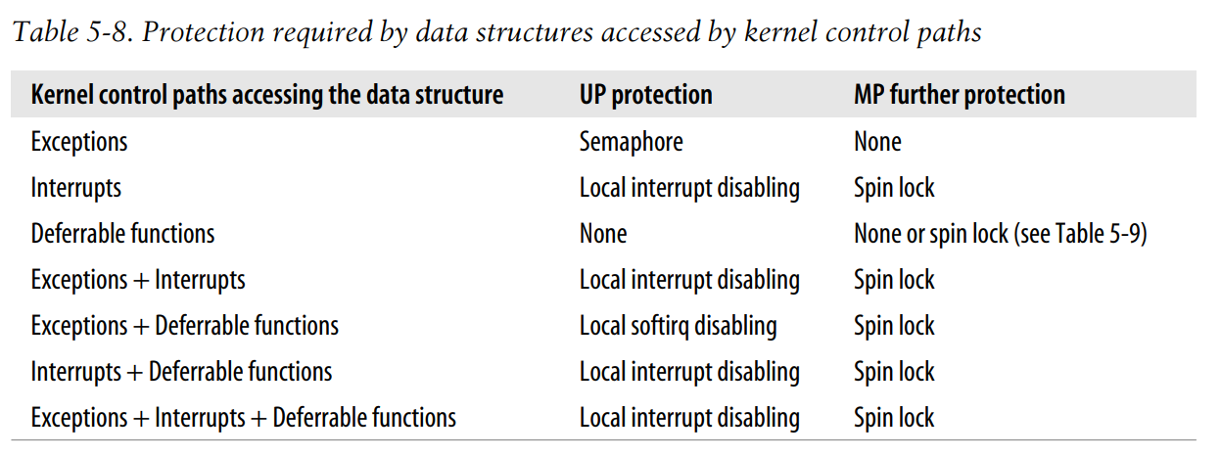
RV College of
Engineering
Go, change the world
Choosing Among Spin Locks, Semaphores, and Interrupt Disabling
Choosing the synchronization primitives depends on what kinds of kernel control paths access the data structure
*

Slide 6
RV College of
Engineering
Go, change the world
Protecting a data structure accessed by exceptions
Race Conditions are easy to understand and prevent
Most common exception is, System Call Service Routine
System Call Service Routine : CPU operates in Kernel Mode to offer a service to a User Mode program
Semaphores are used to avoid race conditions
*

Slide 7
RV College of
Engineering
Go, change the world
Protecting a data structure accessed by interrupts
Case I : When there is a single Interrupt Handler accessing the Shared Data
No synchronization primitives are required, since, Interrupt Handlers are serialized.
Case II : When multiple Interrupt Handlers are accessing the Shared Data
A handler may interrupt another handler, and different interrupt handlers may run concurrently in multiprocessor systems. Synchronization is required.
Uniprocessor System : Disabling Interrupts in all the critical regions of the Interrupt Handler.
Cannot use Spin Locks or Semaphores.
Multiprocessor System : Disabling Local Interrupts + Acquire Spin Lock / Read-or-Write Spin Lock
*

Slide 8
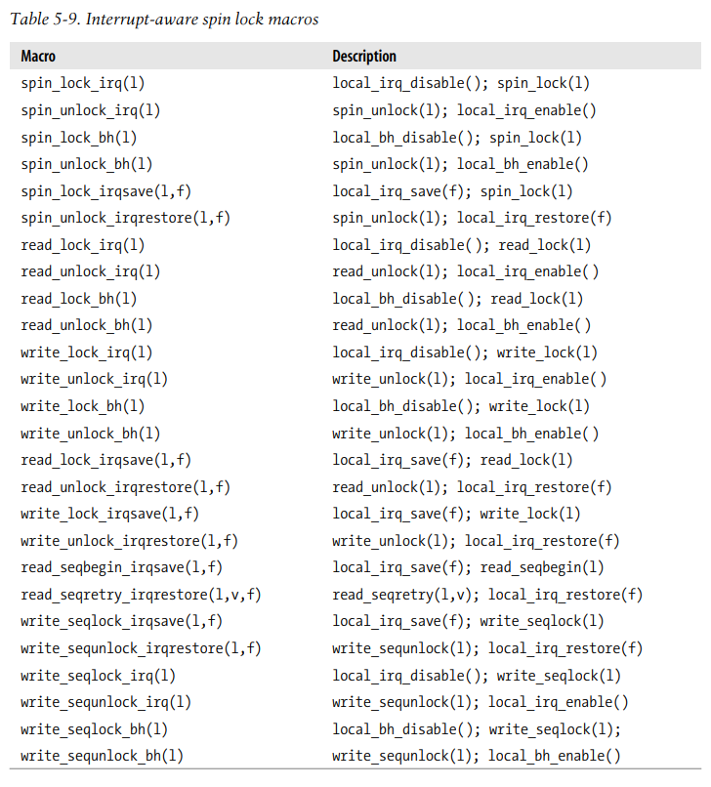
RV College of
Engineering
Go, change the world
Macros used in Linux Kernel
*

Slide 9
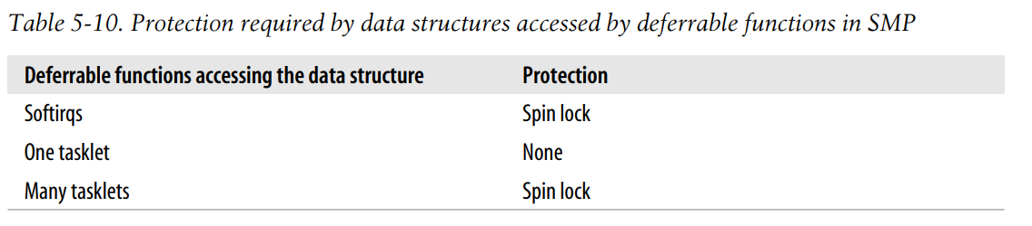
RV College of
Engineering
Go, change the world
Protecting a data structure accessed by deferrable functions
No Race Condition in Uniprocessor Systems : Execution of Deferrable Functions is always serialized
In Multiprocessor Systems, Race Condition Exists
*

Slide 10
RV College of
Engineering
Go, change the world
Protecting a data structure accessed by exceptions and interrupts
On Uniprocessor Systems,
Interrupt Handlers cannot be interrupted by Exceptions
As long as the kernel accesses the data structure with local interrupts disabled, the kernel can not be interrupted when accessing the data structure
If the data structure is accessed by just one kind of interrupt handler, the interrupt handler can freely access the data structure without disabling local interrupts
On Multiprocessor Systems, Local Interrupt Disabling + Spin Lock
*

Slide 11
Thank You

